Slide 1




Learned Query Optimizer: What is New and What is Next
Tutorial
Rong Zhu, Lianggui Weng, Bolin Ding, Jingren Zhou
Institute for Intelligent Computing
Alibaba Group
TONGYI

Slide 2



Speakers
Rong Zhu
Alibaba Group
Lianggui Weng
Alibaba Group
Bolin Ding
Alibaba Group
Jingren Zhou
Alibaba Group

Slide 3
AI-Native Data Management

Slide 4
Towards being AI Native: Tasks and Values
Leveraging AI for traditional database operators and improving performance
Database tuning: AI models as tuners
Statistics estimation: AI models as histograms
Query optimization: AI models as optimizers
Leveraging AI for usability, data analytics, and new applications
Text-to-SQL: an LLM-aided translation task
Data Manipulation: AI-aided data cleaning, data augmentation, and feature generation
Text-to-Insights: AI-aided analytical pipeline generation, copilot
Data processing systems for AI
LLMs as users of the data system, and their evaluation results as feedbacks
Multi-modal data and processors (machine learning models)
Scalability and composability of data processors

Slide 5
Learned Query Optimizer in AI-Native Data Management
Part 1: Preliminaries
Part 2: Learn to Cost Plans
Part 3: Learn to Explore Plan Space
Part 4: Applications and Deployment
Part 5: Summary and Future Work
Bolin Ding, Rong Zhu and Jingren Zhou. Learned Query Optimizers, Foundations and Trends in Databases, 2024

Slide 6
Part 1: Preliminaries
Query Optimizer
Learned Query Optimizer

Slide 7
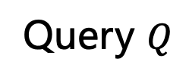

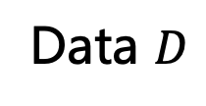
Query Optimizer: a Well-Defined Problem
Generating best physical plan for input query
Directly relates to the system performance
Extensively studied in the literature
DBMS
Data $D$
Query
Optimizer
Plan Execution
Plan $P$
Query $Q$

Slide 8


Query Optimizer: a Difficult Task
Undefined part: plan quality
Determined by data, query, system environment …
Large Search Space: join orders, access paths, …
SELECT COUNT(*)
FROM s, sc, c
WHERE s.sid = sc.sid AND sc.cid = c.cid
AND s.year < 2009 AND c.credit >= 3
MJ, HJ, NJ
MJ, HJ, NJ
MJ, HJ, NJ
MJ, HJ, NJ
Which plan is better?
s
sc
c
s
sc
c
Seq Scan, Index Scan, …
Seq Scan, Index Scan, …

Slide 9



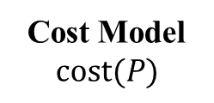
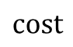
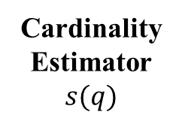
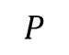
Learned Query Optimizer: a Pioneer in AI4DB
A typical cost-based query optimizer
Database
Query
Cost Model
$$cost(P)$$
$$P$$
Plan Enumerator
formulas and constant numbers
Cardinality Estimator
$$s(q)$$
+
$$cost$$
cost-based search algorithm
sketches
execution engine
Execution Plan

Slide 10
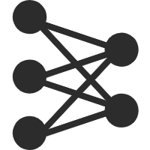


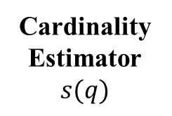
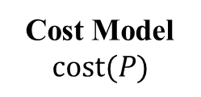
Learned Query Optimizer: a Pioneer in AI4DB
Learned query optimizer: possibilities and opportunities
Database
Query
Cost Model
$$cost(P)$$
learned cost model
learned search policy
Plan Enumerator
formulas and constant numbers
Cardinality Estimator
$$s(q)$$
learned
estimator
+
cost-based search algorithm
sketches
execution statistics
execution engine
Execution Plan
Learned Parts in Query Optimizer

Slide 11






Learned Query Optimizer: Advances and Next
Review on recent works
Classification, comparison and analysis
Guidelines on deployment system
Future work and opportunities
Intelligent Query Optimizer
System Deployment
Explore this journey together!
Applications in Real-World Scenarios
Learn to Explore Plan Space
Learn to Cost Plans
Existing Traditional Query Optimizer

Slide 12
Learned Query Optimizer in AI-Native Data Management
Part 1: Preliminaries
Part 2: Learn to Cost Plans
Part 3: Learn to Explore Plan Space
Part 4: Applications and Deployment
Part 5: Summary and Future Work
Bolin Ding, Rong Zhu and Jingren Zhou. Learned Query Optimizers, Foundations and Trends in Databases, 2024

Slide 13
Part 2: Learn to Cost Plans
Cardinality & Cost
Learn to Estimate Cardinality
Learned Cost Model

Slide 14
Part 2: Learn to Cost Plans
Cardinality & Cost
Learn to Estimate Cardinality
Learned Cost Model

Slide 15
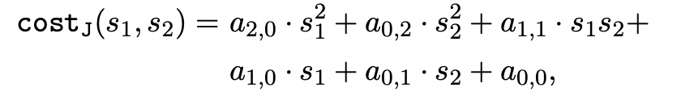
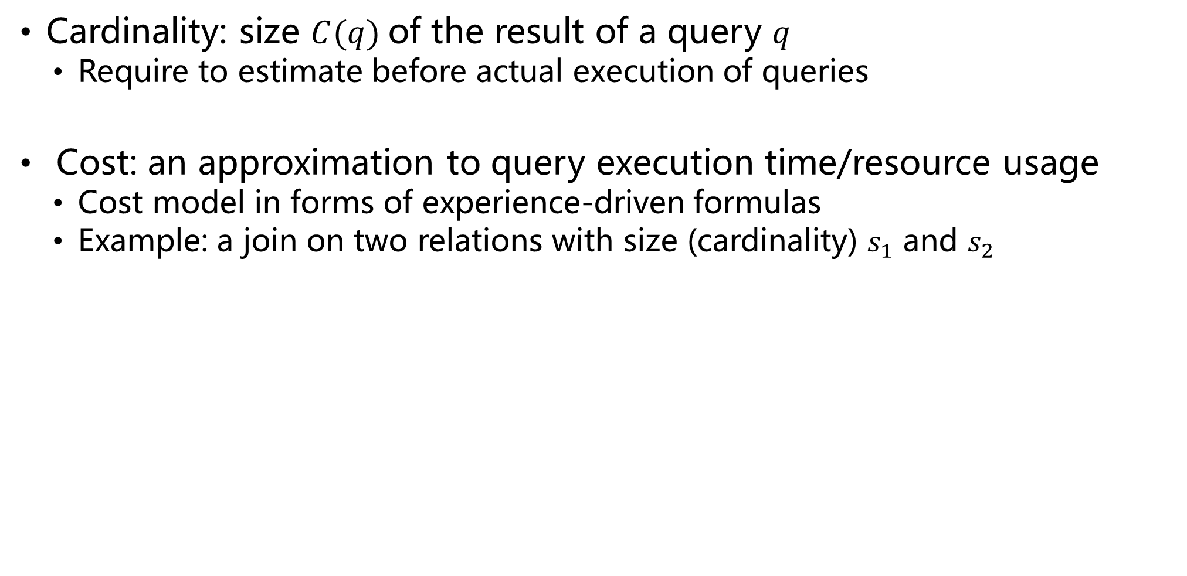
Cardinality & Cost
Cardinality: size $C(q)$of the result of a query $q$
Require to estimate before actual execution of queries
Cost: an approximation to query execution time/resource usage
Cost model in forms of experience-driven formulas
Example: a join on two relations with size (cardinality) $s_{1}$ and $s_{2}$
Expert-tuning Factors
Estimated Cardinality

Slide 16
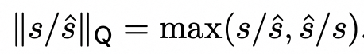
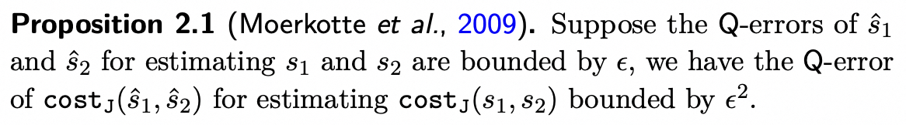
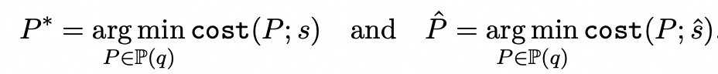
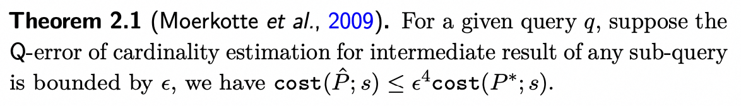
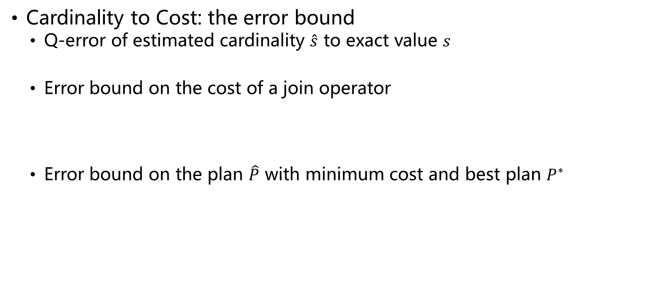
Cardinality & Cost
Cardinality to Cost: the error bound
Q-error of estimated cardinality $\hat{s}$ to exact value $s$
Error bound on the cost of a join operator
Error bound on the plan $\hat{P}$ with minimum cost and best plan $P^{∗}$
(Moerkotte et al, 2009) Preventing Bad Plans by Bounding the Impact of Cardinality Estimation Errors, VLDB 2009

Slide 17
Cardinality & Cost
worst-case
Cardinality to Cost: the error bound
Q-error of estimated cardinality $\hat{s}$ to exact value $s$
Error bound on the cost of a join operator
Error bound on the plan $\hat{P}$ with minimum cost and best plan $P^{∗}$
Inaccurate Cardinality
Inaccurate Cost
Sub-optimal Plan
(Moerkotte et al, 2009) Preventing Bad Plans by Bounding the Impact of Cardinality Estimation Errors, VLDB 2009

Slide 18
Cardinality & Cost
hopefully
Cardinality to Cost: the error bound
Q-error of estimated cardinality $\hat{s}$ to exact value $s$
Error bound on the cost of a join operator
Error bound on the plan $\hat{P}$ with minimum cost and best plan $P^{∗}$
Better Cardinality
Better Cost
Better Plan
(Moerkotte et al, 2009) Preventing Bad Plans by Bounding the Impact of Cardinality Estimation Errors, VLDB 2009

Slide 19
Part 2: Learn to Cost Plans
Cardinality & Cost
Learn to Estimate Cardinality
Learned Cost Model

Slide 20
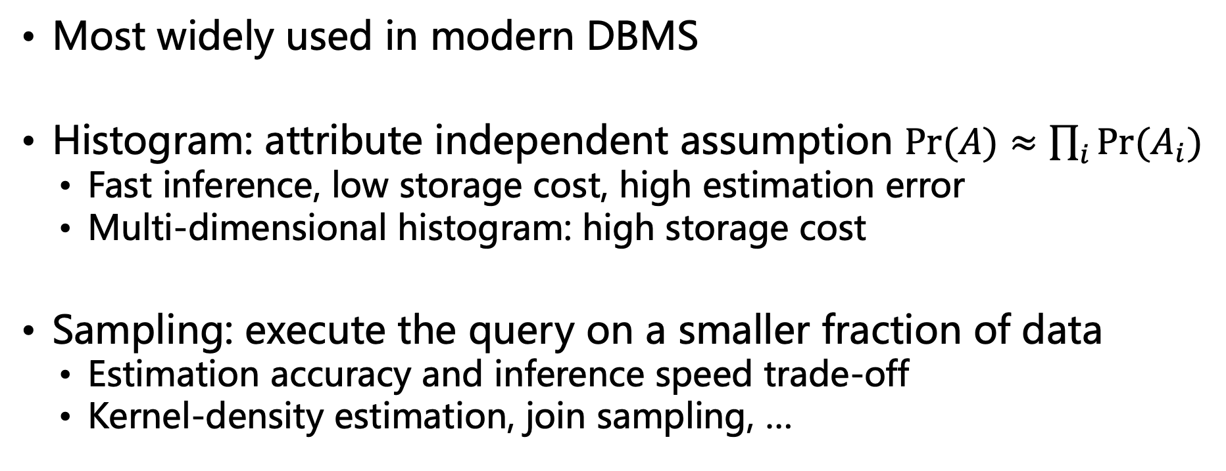
Traditional Methods
Most widely used in modern DBMS
Histogram: attribute independent assumption $\operatorname{Pr}{(A)}≈\prod_{i}{\operatorname{Pr}{(A_{i})}}$
Fast inference, low storage cost, high estimation error
Multi-dimensional histogram: high storage cost
Sampling: execute the query on a smaller fraction of data
Estimation accuracy and inference speed trade-off
Kernel-density estimation, join sampling, …

Slide 21
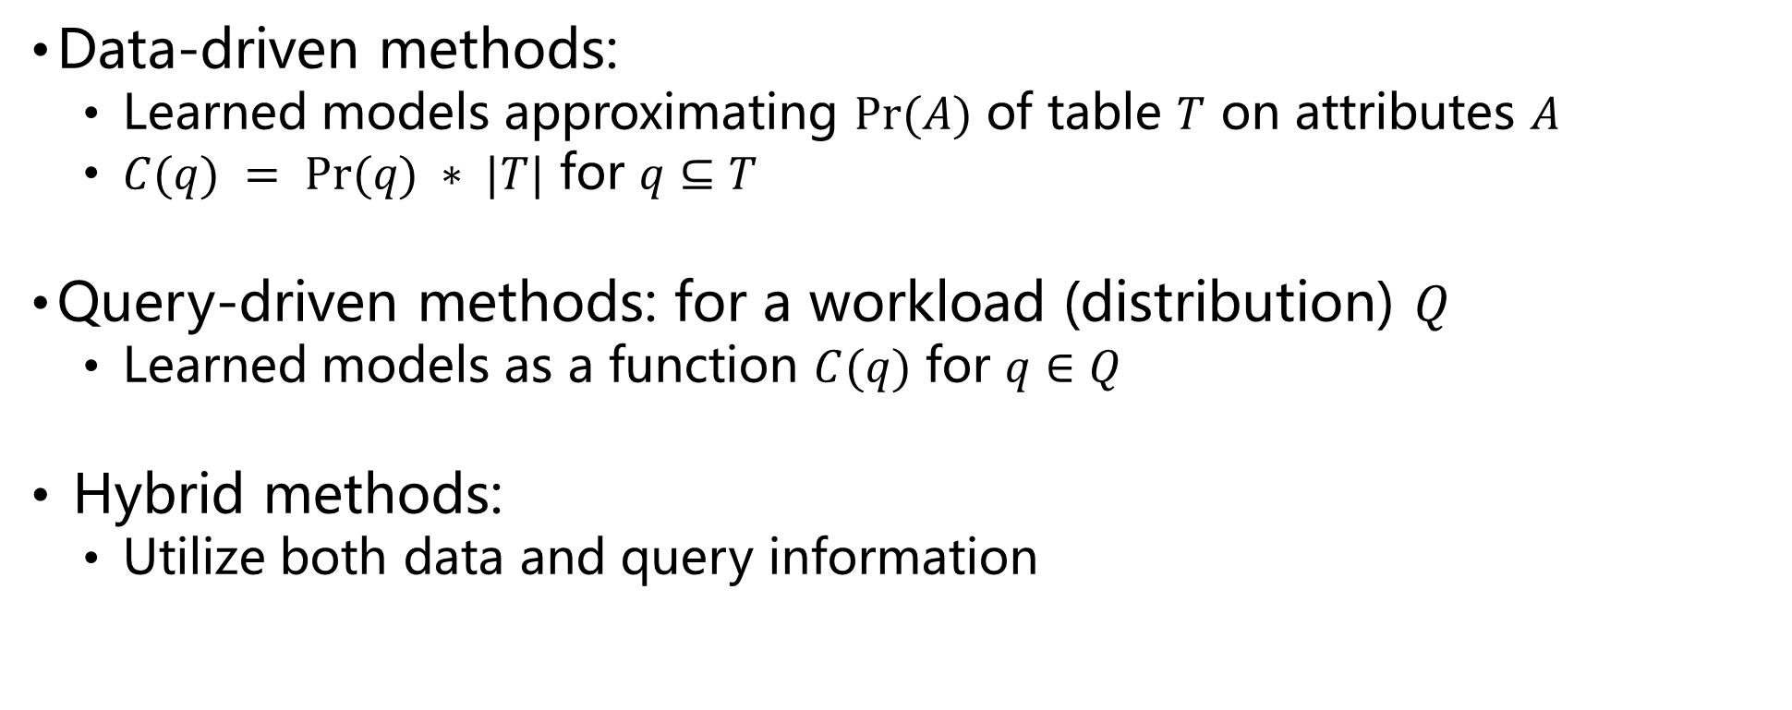
Learned Methods: An Overview
Data-driven methods:
Learned models approximating $Pr⁡(A)$ of table $T$ on attributes $A$
$C(q) = Pr⁡(q) ∗ |T|$ for $q⊆T$
Query-driven methods: for a workload (distribution) $Q$
Learned models as a function $C(q)$ for $q∈Q$
Hybrid methods:
Utilize both data and query information

Slide 22
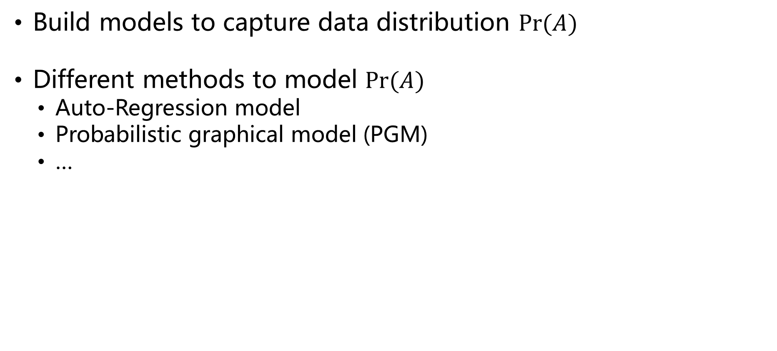
Data-Driven Methods
Build models to capture data distribution $Pr⁡(A)$
Different methods to model $Pr⁡(A)$
Auto-Regression model
Probabilistic graphical model (PGM)
…

Slide 23
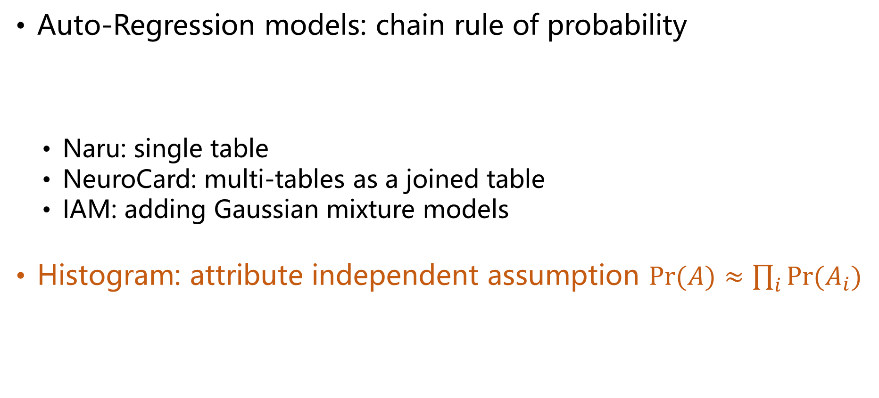
Data-Driven Methods
Auto-Regression models: chain rule of probability
Naru: single table
NeuroCard: multi-tables as a joined table
IAM: adding Gaussian mixture models
Histogram: attribute independent assumption $\operatorname{Pr}{(A)}≈\prod_{i}{\operatorname{Pr}{(A_{i})}}$
$$\operatorname{Pr}\left(A\right)=\operatorname{Pr}\left(A_{1}\right)⋅\operatorname{Pr}\left(A_{2} | A_{1}\right)⋅\operatorname{Pr}\left(A_{3} | A_{2},A_{1}\right)⋯\operatorname{Pr}{(A_{n}|A_{n−1}, A_{n−2},⋯,A_{1})}$$
(Naru) Deep Unsupervised Cardinality Estimation, VLDB 2019
(NeuroCard) NeuroCard: One Cardinality Estimator for All Tables, VLDB 2020
(IAM) Unsupervised Selectivity Estimation by Integrating Gaussian Mixture Models and an Autoregressive Model, EDBT 2022

Slide 24
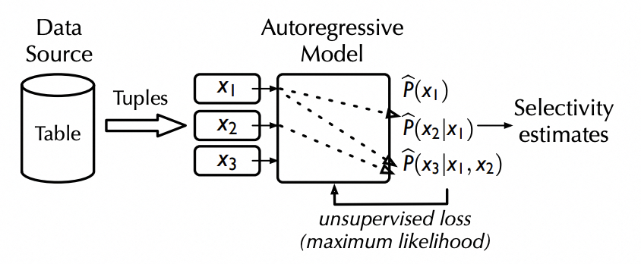
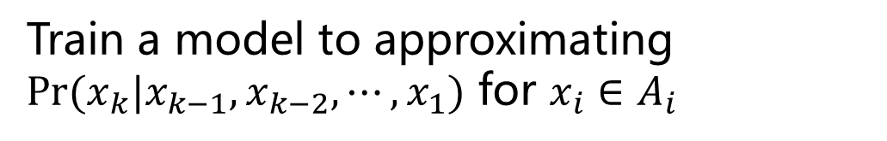
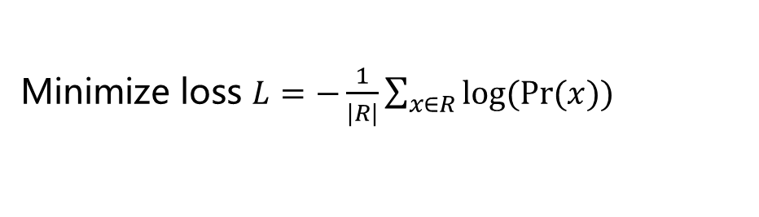

Data-Driven Methods
Auto-Regression models: model training
Train a model to approximating $\operatorname{Pr}{(x_{k}|x_{k−1}, x_{k−2},⋯,x_{1})}$ for $x_{i}∈A_{i}$
Instantiate the network structures:
DARN, MADE, ResMADE and Transformer
Figure from [Deep Unsupervised Cardinality Estimation, VLDB 2019]
Training data: draw tuple $x$ uniformly random from table
Minimize loss $L=−\frac{1}{|R|}\sum_{x∈R}{\log{(\operatorname{Pr}{(x)})}}{ }$

Slide 25
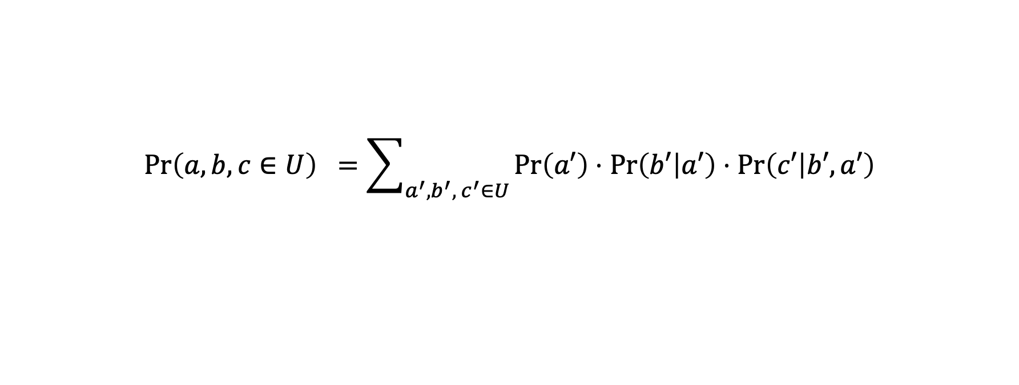
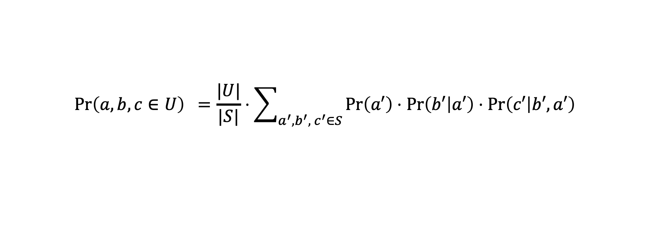
Data-Driven Methods
Auto-Regression models: inference (probability computation)
Point query: compute the probability from model directly
Range query: sum the probability of all points: low efficiency
Speed up by sampling a number of points
Tradeoff between efficiency and accuracy
$$\operatorname{Pr}\left(a,b,c\right)=\operatorname{Pr}\left(A_{1}=a\right)⋅\operatorname{Pr}\left(A_{2}=b | A_{1}=a\right)⋅\operatorname{Pr}\left(A_{3}=c | A_{2}=b,A_{1}=a\right)$$
$$\operatorname{Pr}\left(a,b,c∈U\right) =\sum_{a^{′},b^{′},{ c}^{′}∈U }{\operatorname{Pr}\left(a′\right)⋅\operatorname{Pr}\left(b′ | a′\right)⋅\operatorname{Pr}\left(c′ | b′, a′\right)}$$
$$\operatorname{Pr}\left(a,b,c∈U\right) =\frac{|U|}{|S|}⋅\sum_{a^{′},b^{′},{ c}^{′}∈S }{\operatorname{Pr}\left(a′\right)⋅\operatorname{Pr}\left(b′ | a′\right)⋅\operatorname{Pr}\left(c′ | b′, a′\right)}$$

Slide 26
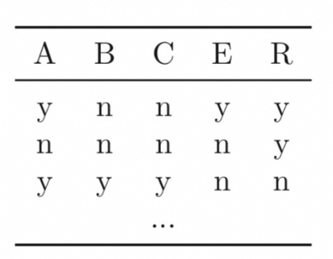
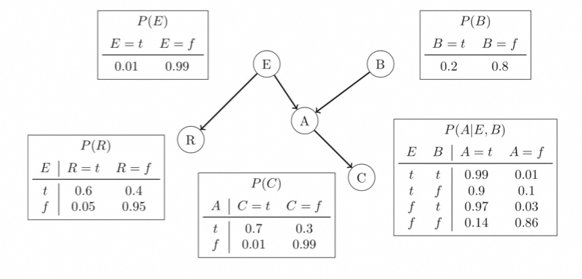
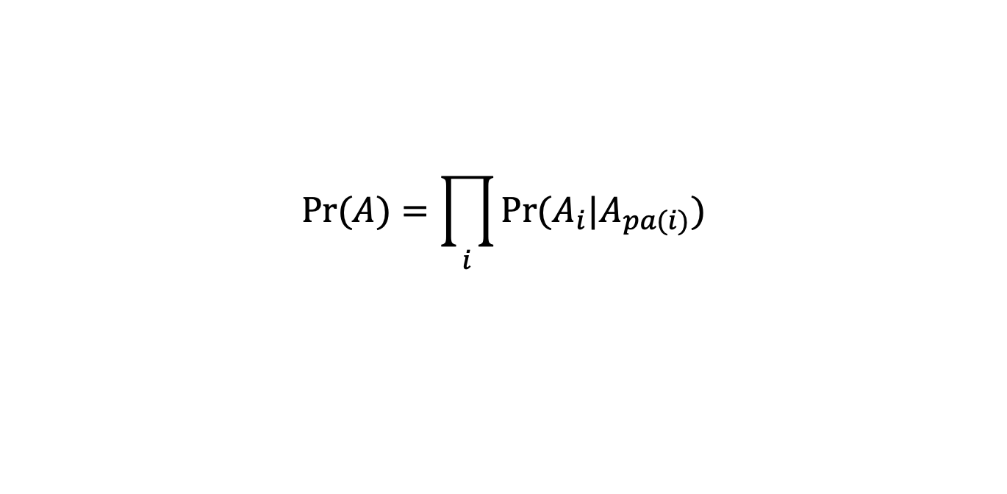
Data-Driven Methods
Probabilistic graphic models (PGM)
Bayesian network: BayesNet and BayesCard
Both structural learning and model inference are NP-Hard problems
$$\operatorname{Pr}{(A)}=\prod_{i}{\operatorname{Pr}{(A_{i}|A_{pa(i)})}}$$
Figure from [A survey on Bayesian network structure learning from data, Progress in Artificial Intelligence, 2019]
(BayesNet) Lightweight Graphical Models for Selectivity Estimation Without Independence Assumptions, VLDB 2011
(BayesCard) BayesCard: A Unified Bayesian Framework for Cardinality Estimation, ArXiv, 2021

Slide 27
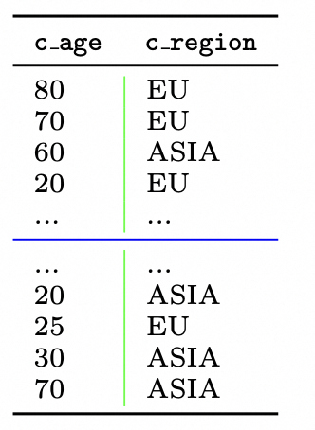
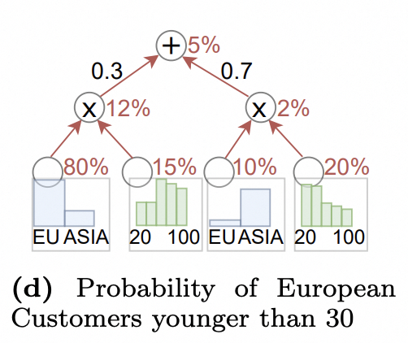
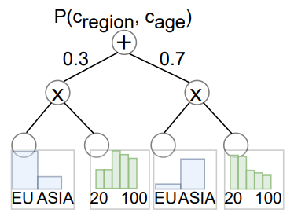

Data-Driven Methods
Different probabilistic graphic models (PGM)
Sum-Product network (SPN): DeepDB
Model training: split data or attribute
Split the data by rows to find local independent attributes
Split attributes (columns) and build histograms on local data
Model inference: bottom up, linear cost to the node size
Accuracy, speed, and model size: sensitive to attribute correlations
Figure from [DeepDB: Learn from Data, not from Queries!, VLDB 2020]

Slide 28
Data-Driven Methods
Different probabilistic graphic models (PGM)
FSPN: FLAT
Adaptively process highly and weakly correlated attributes
Factorize node: losslessly split highly and weakly correlated attributes
SPN: model weakly correlated attributes
Combining the advantages from BN and SPN, no assumptions on correlations
High accuracy and small model size, low Inference time
W = { WT, TP }
weakly correlated
H = { WH, WF }
highly correlated
①
$$N_{1}$$
WT (NTU) | TP (°F) | WH (m) | WF (m/s)
1.27 | 43.7 | 0.9 | 5.5
0.63 | 46.3 | 3.7 | 16.2
0.55 | 51.6 | 3.2 | 14.9
… | … | … | …
2.61 | 62.8 | 1.5 | 8.9
1.18 | 60.5 | 4.7 | 18.9
0.97 | 73.6 | 2.1 | 11.7
TP < 50°F?
TP < 55°F?
$$N_{2}$$
factorize
sum
split
$$N_{3}$$
0.3
0.7
WT < 0.9?
WT < 1.2?
product
$$N_{4}$$
$$N_{5}$$
$$N_{6}$$
$$N_{7}$$
$$L_{1}$$
$$L_{2}$$
$$L_{3}$$
$$L_{4}$$
$$L_{5}$$
$$L_{6}$$
$$L_{7}$$
$$L_{8}$$
﻿univariate leaf
﻿multivariate leaf
(FLAT) FLAT: Fast, Lightweight and Accurate Method for Cardinality Estimation, VLDB 2021

Slide 29
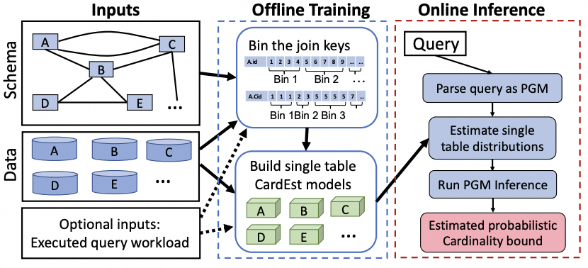
Data-Driven Methods
Other techniques
FactorJoin:
histogram on join -> factor graph
FACE: normalizing flow
Iris: pretraining summarization models
Figure from [FactorJoin: A New Cardinality Estimation Framework for Join Queries, SIGMOD 2023]
(FactorJoin) FactorJoin: A New Cardinality Estimation Framework for Join Queries, SIGMOD 2023
(FACE) FACE: A Normalizing Flow based Cardinality Estimator, VLDB 2021
(Iris) Pre-training Summarization Models of Structured Datasets for Cardinality Estimation, VLDB 2021

Slide 30
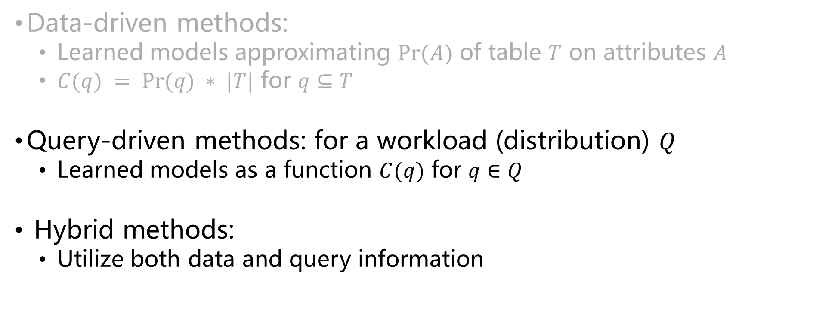
Learned Methods: An Overview
Data-driven methods:
Learned models approximating $Pr⁡(A)$ of table $T$ on attributes $A$
$C(q) = Pr⁡(q) ∗ |T|$ for $q⊆T$
Query-driven methods: for a workload (distribution) $Q$
Learned models as a function $C(q)$ for $q∈Q$
Hybrid methods:
Utilize both data and query information

Slide 31
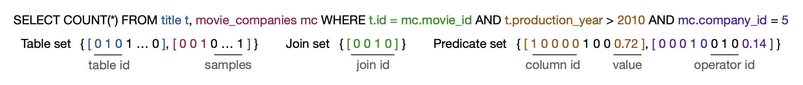
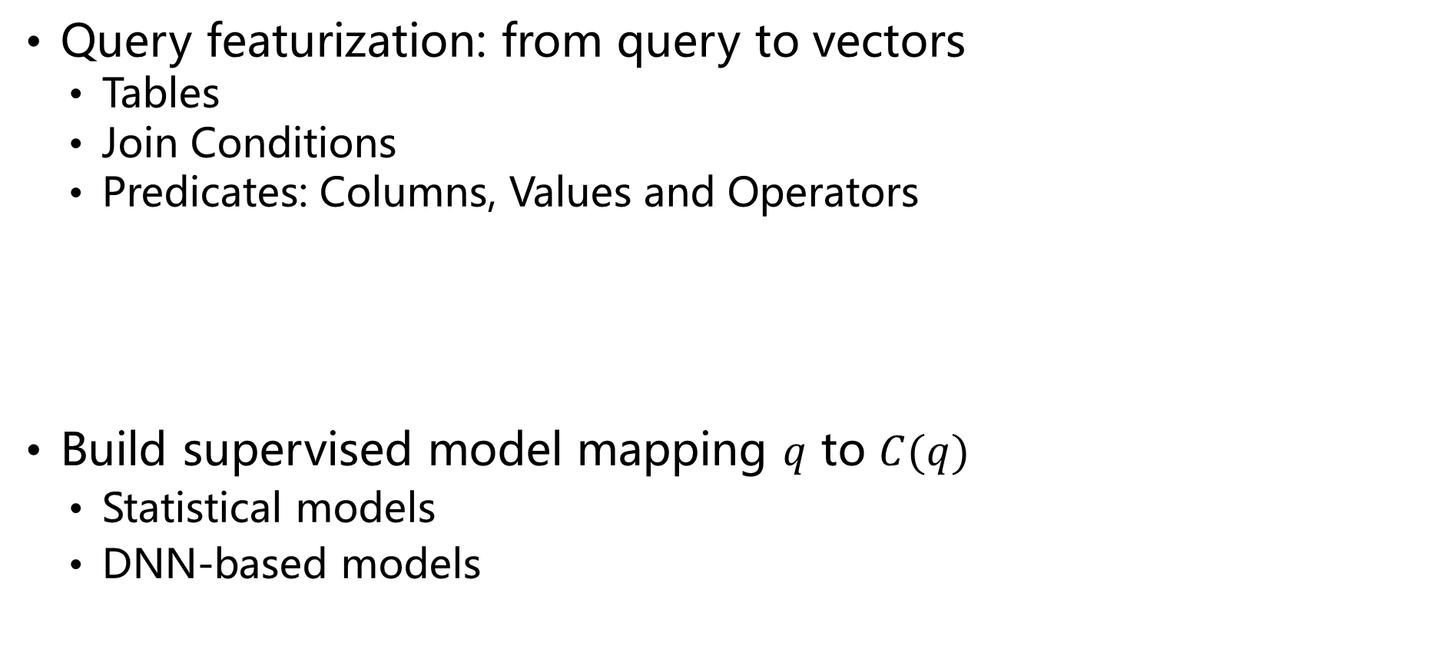
Query-Driven Methods
Query featurization: from query to vectors
Tables
Join Conditions
Predicates: Columns, Values and Operators
Build supervised model mapping $q$ to $C(q)$
Statistical models
DNN-based models
Figure from [Learned Cardinalities: Estimating Correlated Joins with Deep Learning, CIDR 2019]

Slide 32
Query-Driven Methods
Statistical models:
Linear model
Tree-based Ensembles
XGBoost
QuickSel: a mixture of models with overlaps
(Linear) A Black-Box Approach to Query Cardinality Estimation, CIDR 2007
(Tree) Selectivity Estimation for Range Predicates using Lightweight Models, VLDB 2019
(XGBoost) Approximating Selectivity Functions using Low Overhead Regression Models, VLDB 2020
(QuickSel) QuickSel: Quick Selectivity Learning with Mixture Models, SIGMOD 2020

Slide 33
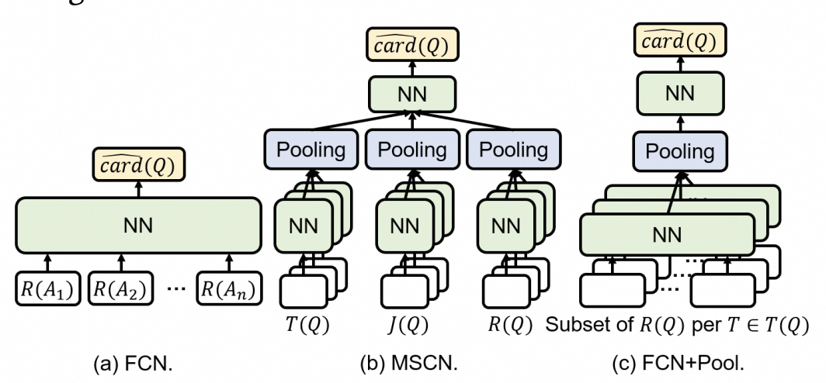
Query-Driven Methods
DNN-based models:
FCN: fully connected neural network
FCN+Pool: adding pooling layers
MSCN: multi-set convolutional network
CRN: learning containment rate between
a pair of queries
Robust-MSCN: query masking to improve
generalization ability
Figure from [Learned Cardinality Estimation: An In-depth Study, SIGMOD 2022]
(FCN) Cardinality estimation using neural networks, CASON 2015
(FCN+Pool) Learned Cardinality Estimation: An In-depth Study, SIGMOD 2022
(MSCN) Learned Cardinalities: Estimating Correlated Joins with Deep Learning, CIDR 2019
(CRN) Improved Cardinality Estimation by Learning Queries Containment Rates. EDBT 2020
(Robust-MSCN) Robust Query Driven Cardinality Estimation under Changing Workloads, VLDB 2023

Slide 34
Query-Driven Methods
Advanced techniques
Fauce: an ensemble of deep models
Learn cardinality and uncertainty together
GL+: DNNs + segmentation techniques
Resolve the data hungry problem
NNGP: Bayesian deep learning models
LPCE: re-optimization framework
(Fauce) Fauce: Fast and Accurate Deep Ensembles with Uncertainty for Cardinality Estimation, VLDB 2021
(GL+) Learned Cardinality Estimation for Similarity Queries, SIGMOD 2021
(NNGP) Lightweight and Accurate Cardinality Estimation by Neural Network Gaussian Process, SIGMOD 2022
(LPCE) Speeding Up End-to-end Query Execution via Learning-based Progressive Cardinality Estimation, SIGMOD 2023

Slide 35
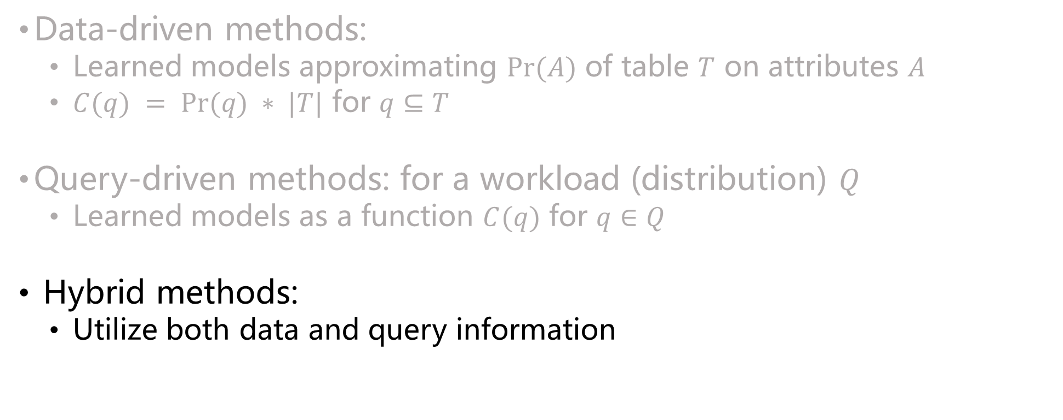
Learned Methods: An Overview
Data-driven methods:
Learned models approximating $Pr⁡(A)$ of table $T$ on attributes $A$
$C(q) = Pr⁡(q) ∗ |T|$ for $q⊆T$
Query-driven methods: for a workload (distribution) $Q$
Learned models as a function $C(q)$ for $q∈Q$
Hybrid methods:
Utilize both data and query information

Slide 36
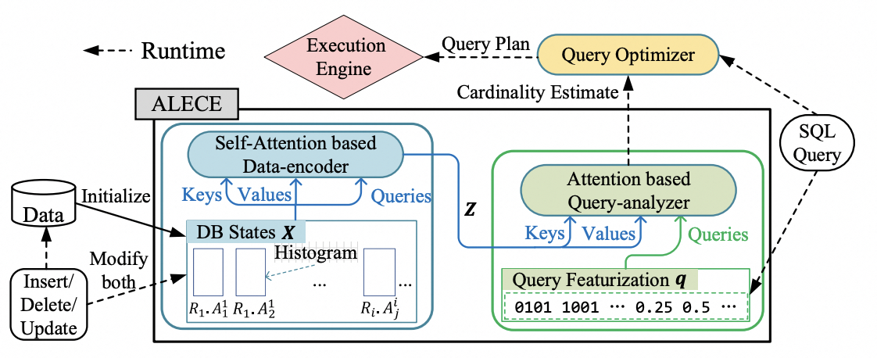
Hybrid Methods
ALECE: discover the hidden relationships between queries and underlying data using attention + transformer models
Data features (e.g., histogram of each attribute) + Query features
Process static and dynamic data in the same way
(ALECE) ALECE: An Attention-based Learned Cardinality Estimator for SPJ Queries on Dynamic Workloads, VLDB 2023

Slide 37
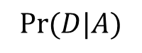
Hybrid Methods
ALECE: utilize both query and data information
$$Pr⁡(D|A)$$
Data Encoder: an attention module learn the information of high-order data distributions using low-level histograms on each attribute
(ALECE) ALECE: An Attention-based Learned Cardinality Estimator for SPJ Queries on Dynamic Workloads, VLDB 2023

Slide 38
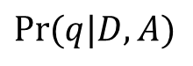
Hybrid Methods
ALECE: utilize both query and data information
$$Pr⁡(D|A)$$
$$Pr⁡(q|D,A)$$
Query Analyzer: an attention module learn the joint information between data distribution and featuralized queries
(ALECE) ALECE: An Attention-based Learned Cardinality Estimator for SPJ Queries on Dynamic Workloads, VLDB 2023

Slide 39
Benchmark Evaluations
Cardinality estimation on single table
Analyze whether these methods are suitable for deploying
End-to-end evaluation of query optimization/processing
Guidance to select methods in various practical scenarios
New benchmarks and comprehensive evaluations
New dataset STATS: real-world data with complicated distributions
End-to-End evaluation on actual DBMS (PostgreSQL)
(Single Table) Are We Ready For Learned Cardinality Estimation?, VLDB 2021
(Space Exploration) Learned Cardinality Estimation: A Design Space Exploration and A Comparative Evaluation, VLDB 2021
(STATS) Cardinality Estimation in DBMS: A Comprehensive Benchmark Evaluation, VLDB 2021

Slide 40
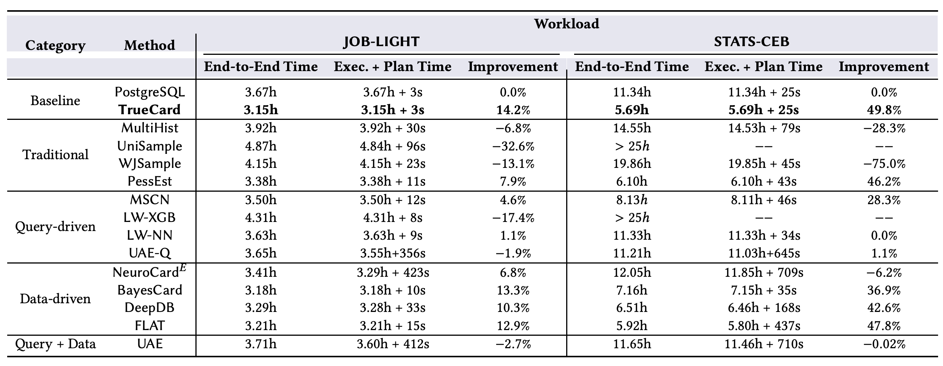
Benchmark Evaluations
Learned methods could help, but not always
Experimental data from [Cardinality Estimation in DBMS: A Comprehensive Benchmark Evaluation, VLDB 2021]

Slide 41
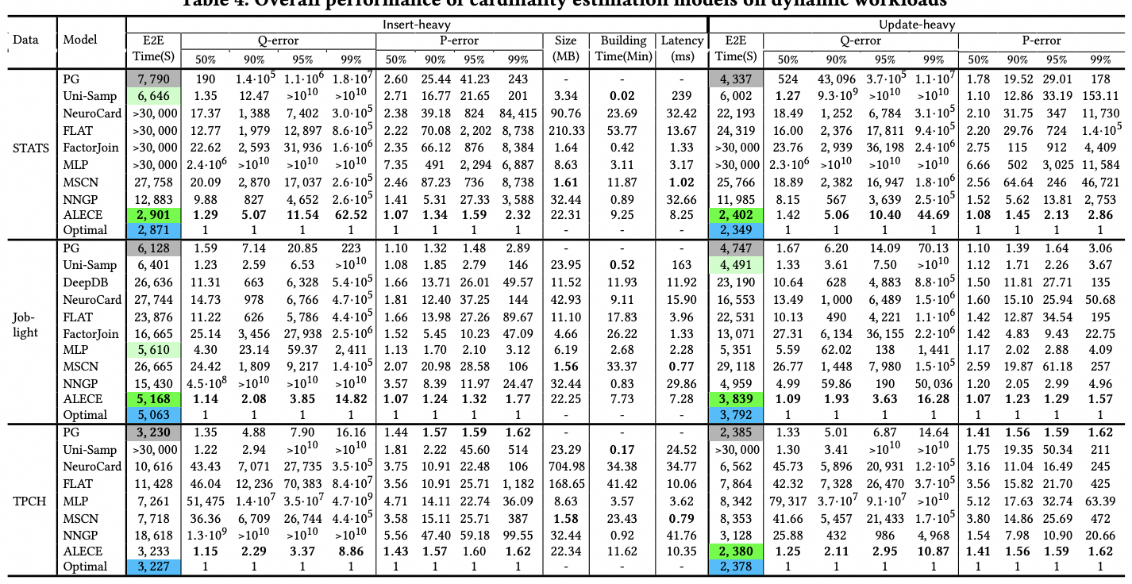
Benchmark Evaluations: Dynamic Settings
Experimental data from [ALECE: An Attention-based Learned Cardinality Estimator for SPJ Queries on Dynamic Workloads, VLDB 2023]

Slide 42
Part 2: Learn to Cost Plans
Cardinality & Cost
Learn to Estimate Cardinality
Learned Cost Model

Slide 43
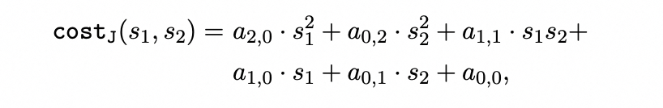
Learned Cost Model
Cost: an approximation to execution time/resource usage
Traditional cost model: expert-tuned formulas on cardinality
Learned methods
Costing a single plan:
use previous plans to train a cost model
Costing plans for concurrent queries:
consider the correlations between plans and predict the cost

Slide 44
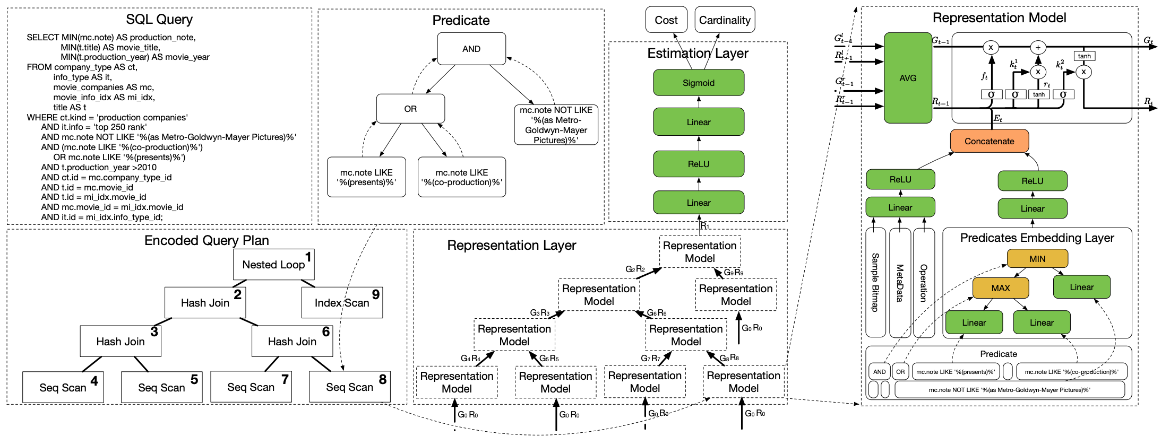
Cost Estimation for Single Plans
Output and Memory of left and right child
Tree LSTM: plan as a sequence
$$\left(h_{p}, m_{p}\right)=LSTM(x_{p}, \left(h_{l}, m_{l}\right), (h_{r}, m_{l}))$$
Encoding of node P
Output and Memory
of node P
Traverse each node in the plan as a sequence to feed into the LSTM representation model using the node and children information
Encode each node in the plan
Figure from [An End-to-End Learning-based Cost Estimator, VLDB 2019]

Slide 45
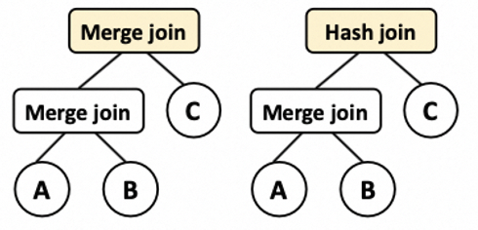
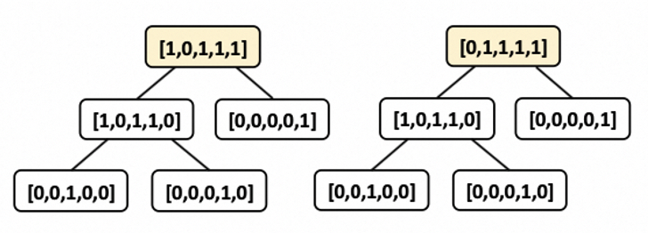
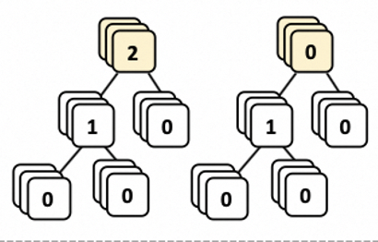
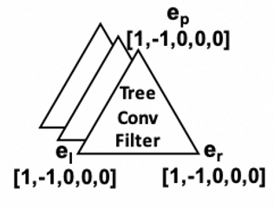
Cost Estimation for Single Plans
Tree convolutional network (TCN): plan as a tree
Triangle sliding window on each node and its two children
Features on each node
Figure from [Neo: A Learned Query Optimizer, VLDB 2019]
Recursion
Tree Filter: shared model (e.g., a MLP) on each sliding window
Additional layers on final output to predict the cost
Aggregated Results
(TCN) Plan-Structured Deep Neural Network Models for Query Performance Prediction , VLDB 2019

Slide 46
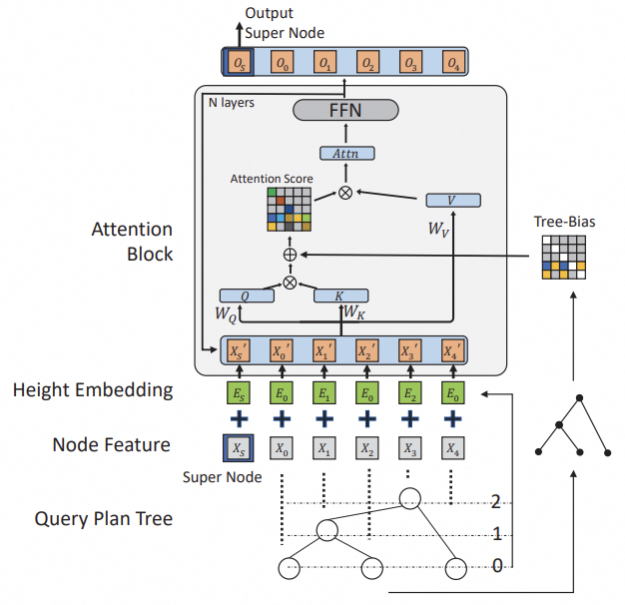
Cost Estimation for Single Plans
Other ways to capture the tree structure information
Saturn: traverse and compress plans as vectors
QueryFormer: a transformer to learn
embeddings of plans, appliable to multiple
downstream tasks
Figure from [QueryFormer: A Tree Transformer Model for Query Plan Representation, VLDB 2022]
(Saturn) Efficient Learning with Pseudo Labels for Query Cost Estimation, CIKM 2022

Slide 47
Cost Estimation for Plans of Concurrent Queries
Challenges: queries have complex correlations
Solutions: modeling the correlations using graphs
GPredictor: using graph neural networks for cost prediction
Figure from [Performance Prediction for Concurrent Queries using Graph Embedding, VLDB 2020]

Slide 48
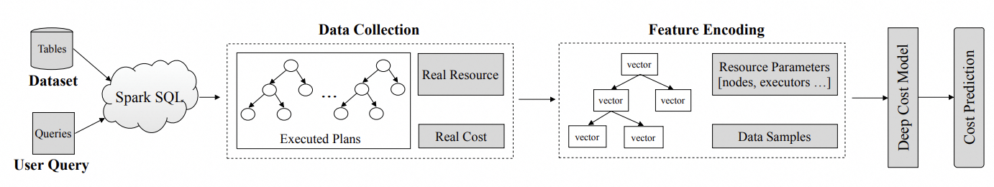
Cost Estimation for Plans of Concurrent Queries
Prestroid: apply tree convolutional networks for concurrent queries
RAAL: end-to-end deep cost model with attention mechanism applied in cloud environment
Figure from [A Resource-Aware Deep Cost Model for Big Data Query Processing, ICDE 2022]
(Prestroid) Efficient Deep Learning Pipelines for Accurate Cost Estimations Over Large Scale Query Workload , SIGMOD 2021

Slide 49
Part 3: Learn to Explore Plan Space
Search by Value Networks
Search by Steering Existing Query Optimizers
Search and Rank Plans
Quality Control of Learned Query Optimizers

Slide 50





Plan Search in Query Optimizer
The general framework
Traditional plan exploration methods
Exact: Dynamic programming
Heuristic: Genetic or greedy search …
Candidate Plans
Plan Exploration
Plan Selection
$$P_{1}$$
$$P_{2}$$
$$P^{∗}$$
Query $Q$
Execution Engine
…
…
…
Results
$$P_{n}$$

Slide 51
Part 3: Learn to Explore Plan Space
Search by Value Networks
Search by Steering Existing Query Optimizers
Search and Rank Plans
Quality Control of Learned Query Optimizers

Slide 52





Search by Value Networks
Value network: Predicate the best possible plan $P$ containing partial plan $P′$ of query $Q$
Tree convolutional network or other models
$P_{0},P_{1}, P_{2}⊆P_{3}$
Query $Q$
Value Network
Latency $t=min \left\{t\left(P\right)\right|P is a plan of Q,P^{′}⊆P\}$
Partial Plan $P′$
Figure from [Neo: A Learned Query Optimizer, VLDB 2019]

Slide 53

Search by Value Networks
Search plan space from scratch with value networks
Neo: best-first search
1000
s
c
100
s
s
sc
Expand the best branch in the search process
s
sc
c
(Neo) Neo: A Learned Query Optimizer, VLDB 2019

Slide 54
Search by Value Networks
Search plan space from scratch with value networks
Balsa: beam search
1000
……
s
c
……
s
100
……
s
sc
t
s
sc
Expand the best k branches in the search process
(Balsa) Balsa: Learning a Query Optimizer Without Expert Demonstrations, SIGMOD 2022
Notes:
太快，介绍一下beam search概念，扩展一下

Slide 55


Search by Value Networks
Search plan space from scratch with value networks
LOGER: $ε$-beam search
1000
……
s
c
……
s
100
……
s
sc
t
s
sc
Expand the a random number (decided by $k$ and $ε$) of branches in the search process
(LOGER) LOGER: A Learned Optimizer towards Generating Efficient and Robust Query Execution Plans, VLDB 2023
Notes:
太快，介绍一下beam search概念，扩展一下

Slide 56

Search by Value Networks
Model training
Exact label is difficult to obtain
Using the latency of the best plan we can obtain as training label
Update model with collected workload in periodical
Shortcomings:
Cold-start
Balsa/BASE: Bootstrap with existing cost model
Large search space
Not effective to obtain truly good plans
Figure from [Balsa: Learning a Query Optimizer Without Expert Demonstrations, SIGMOD 2022]
(BASE) BASE: Bridging the Gap between Cost and Latency for Query Optimization, VLDB 2023

Slide 57
Part 3: Learn to Explore Plan Space
Search by Value Networks
Search by Steering Existing Query Optimizers
Search and Rank Plans
Quality Control of Learned Query Optimizers

Slide 58

Search by Steering Existing Query Optimizer
Tune the existing query optimizer to search different paths in the plan space
Reduce the search space
Reuse existing query optimizer, easy for deployment

Slide 59


Different Tuning Knobs
Bao: tune the hint set
Enable/Disable certain types of operations
Disable the nested loop join
HyperQO: tune the leading hints on join order
Figure from [Bao: Making Learned Query Optimization Practical, SIGMOD 2021]
Figure from [Cost-based or Learning-based? A Hybrid Query Optimizer for Query Plan Selection, VLDB 2022]

Slide 60

Disadvantages
Large space of knobs
$h$ hints → $2^{h}$ possible hint sets
AutoSteer: Automated suitable hint-set discovery
Latency prediction is a very difficult problem
Large learning space: data, query, system and other factors …
Select in-optimal plans
Slow model updating
…
(AutoSteer) AutoSteer: Learned Query Optimization for Any SQL Database, VLDB 2023

Slide 61
Part 3: Learn to Explore Plan Space
Search by Value Networks
Search by Steering Existing Query Optimizers
Search and Rank Plans
Performance Quality Control

Slide 62






Query Optimizer: A Better Solution
Is it really necessary to know the exact time of each plan?
No, we just need to know which plan is better!
From learning-to-predict to learning-to-rank
Low learning difficulty with more benefits
Accurate model, fast learning and updating…
$$P_{1}$$
$$P_{2}$$
$$P_{3}$$
$$P_{n}$$
$$P_{1}$$
$$P_{2}$$
$$P_{3}$$
$$P_{n}$$
Plans
……
……
……
……
Latency Time Interval
Hidden Rank Score Interval
(a) Learning Exact Latency
(b) Learning Rank Scores

Slide 63
Query Optimizer: A Better Solution
Is it really necessary to know the exact time of each plan?
No, we just need to know which plan is better!
From learning-to-predict to learning-to-rank
Low learning difficulty with more benefits
Accurate model, fast learning and updating…
$$P_{1}$$
$$P_{2}$$
$$P_{3}$$
$$P_{n}$$
$$P_{1}$$
$$P_{2}$$
$$P_{3}$$
$$P_{n}$$
Plans
……
……
……
……
Latency Time Interval
Hidden Rank Score Interval
(a) Learning Exact Latency
(b) Learning Rank Scores

Slide 64



Query Optimizer: Learn to Rank Plans
Lero: learning-to-rank based query optimizer
Pairwise learning-to-rank model
Plan comparator $CmpPlan(P_{1}, P_{2})$
Commutativity
$CmpPlan\left(P_{1}, P_{2}\right)=1−CmpPlan\left(P_{2}, P_{1}\right)$
Transitivity
$P_{1}>P_{2}, P_{2}>P_{3}⇒P_{1}>P_{3}$
(Lero) Lero: A Learning-to-Rank Query Optimizer, VLDB 2023
Notes:
rank score的传递律和交换律要提一下,中间加一页

Slide 65
Query Optimizer: Learn to Rank Plans
Lero: learning-to-rank based query optimizer
Pairwise learning-to-rank model
Embedding each pair of plans with shared parameters
0/1 signal rather than exact time as training label → more robust
pre-training the embedding model to align with the existing cost model → inheriting the wisdom, no cold-start
Notes:
rank score的传递律和交换律要提一下,中间加一页

Slide 66



























Query Optimizer: Learn to Rank Plans
Plan exploration in Lero: tune cardinality of all sub-queries
Group sub-queries together
Scale up/down their cardinality → could find better one with theoretical analysis
Plan diversity
Different plan shapes
Different join orders
$$P_{1}$$
$$P_{2}$$
$$P_{3}$$
$$⋈$$
$$P_{4}$$
$$⋈$$
$$⋈$$
$$⋈$$
$$⋈$$
$$D$$
$$⋈$$
$$B$$
$$⋈$$
$$D$$
$$⋈$$
$$⋈$$
$$⋈$$
$$C$$
$$⋈$$
$$A$$
$$⋈$$
$$B$$
$$A$$
$$B$$
$$C$$
$$D$$
$$A$$
$$B$$
$$C$$
$$D$$
$$A$$
$$C$$

Slide 67



Benchmark Evaluation
Lero performs better than others
Static and dynamic settings
Could we ultimately eliminate such performance regressions without affecting the benefits?
Experimental data from [Lero: A Learning-to-Rank Query Optimizer, VLDB 2023]

Slide 68
Part 3: Learn to Explore Plan Space
Search by Value Networks
Search by Steering Existing Query Optimizers
Search and Rank Plans
Quality Control of Learned Query Optimizers

Slide 69


Learned Query Optimizer: Quality Control
HyperQO: an ensemble model to learn multiple prediction results of each plan
Plans having large variance are filtered before selection
Small variance $≠$ accurate estimation
Bad plans may be reserved if all models make the same mistake
Figure from [Cost-based or Learning-based? A Hybrid Query Optimizer for Query Plan Selection, VLDB 2022]

Slide 70

Learned Query Optimizer: Quality Control
Eraser: eliminate regressions while preserving benefits
Unexpected plan explorer
A coarse-grained filter removing all
highly risky plans with unseen feature
values
Segment model
A fine-grained model to evaluate the
quality of each plan for plan selection
(Eraser) Eraser: Eliminating Performance Regression on Learned Query Optimizer, VLDB 2024

Slide 71

Learned Query Optimizer: Quality Control
Evaluation results of Eraser
Learned query optimizer performs worse than traditional one
Eraser could eliminate the performance regressions
Learned query optimizer performs better than traditional one
Eraser has very little impact on the performance improvements
Experimental data from [Eraser: Eliminating Performance Regression on Learned Query Optimizer, VLDB 2024]

Slide 72
Part 4: Applications and Deployment
Prototype Applications
Learned cost model for SCOPE in Microsoft
Learn to steer SCOPE in Microsoft
OpenGauss
PilotScope: A Middleware System for Deployment

Slide 73
Part 4: Applications and Deployment
Prototype Applications
Learned cost model for SCOPE in Microsoft
Learn to steer SCOPE in Microsoft
OpenGauss
PilotScope: A Middleware System for Deployment

Slide 74

Learned Cost Model in SCOPE
SCOPE: the big data system for data analytics in Microsoft
Learned cost models could improve plan quality of production jobs
Figure from [Cost Models for Big Data Query Processing: Learning, Retrofitting, and Our Findings, SIGMOD 2020]

Slide 75

SCOPE and Its Hints
SCOPE: tuning different hints
256 hints in total, 100-150 hints are used frequently
Typically 10 − 20 hints are used in a single job
Analyze to discover suitable hint set to steer SCOPE
Figure from [Steering Query Optimizers: A Practical Take on Big Data Workloads, SIGMOD 2021]

Slide 76


Learn to Steer SCOPE
Online deployment: large improvements, small regressions
Figure and Table from [Steering Query Optimizers: A Practical Take on Big Data Workloads, SIGMOD 2021]

Slide 77

OpenGauss: Automatic DB
Multiple learned components
are deployed into GaussDB
Query rewriter
Cardinality/Cost Estimator
Plan Enumerator
…
Traditional Methods as backups
Difficult to extend to other AI4DB methods and DB systems
Figure from [openGauss: An Autonomous Database System, VLDB 2021]

Slide 78
Part 4: Applications and Deployment
Prototype Applications
Learned cost model for SCOPE in Microsoft
Learn to steer SCOPE
OpenGauss
PilotScope: A Middleware System for Deployment

Slide 79




PilotScope: Motivations
AI4DB algorithms are developing very fast ……
A fundamental problem is still not well studied
Could they actual contribute to real world DBMS?
If so, to what extent?
If not, why not?
This could only be answered by actual deployment (gold standard)
Examine in real systems, on real data, report real performance
The pros & cons of each method
……
→ guide future research towards the right direction
Cost Model
Query Optimizer
. . .
Knob Tuning
Index
Recommendation
(PilotScope) PilotScope: steering databases with ML drivers , VLDB 2024

Slide 80

PilotScope: Existing Solutions
Deploying specific algorithm into specific DB
Learned query optimizer/cost model → SCOPE
Knob tuning/query optimizer → openGauss
Workload forecasting/behavior modeling → NoisePage
……
. . .
Notes:
Term问题

Slide 81

PilotScope: Existing Solutions
Limitations of existing solutions
Not general to other AI4DB algorithms & databases
Very expensive: $O(m∗n)$ tailored solutions for $m$ algorithms & $n$ databases
Not friendly to developers
Require close cooperation and learning between ML and DB developers
. . .
. . .

Slide 82

PilotScope: Our Principle
What we desire of the AI4DB deployment?
One system generally appliable for multiple algorithms & databases
General to algorithm: support different AI4DB tasks
General to system: the same ML program could run on different systems
Easy to extensible to other AI4DB algorithms/database systems

Slide 83


PilotScope: Our Principle
What we desire of the AI4DB deployment?
ML & DB developers could work independently
Developers could focus on writing their own programs
Not need to know details in other side
ML Developer
DB Developer

Slide 84

PilotScope: Our Principle
What we desire of the AI4DB deployment?
The minimal impact to the native databases
Low risks to DB
Low learning cost to databases users
DB User
ML Developer
DB Developer
Notes:
改成一句话

Slide 85
PilotScope: Challenges
A desirable deployment system is very challenging
ML and DB have very different paradigms: language, dependency, …
AI4DB algorithms are very diversified
An AI4DB task usually involves a long pipeline on data interaction
Database systems are very complex
Difficult and risky to modify the codebase
……

Slide 86



PilotScope: Framework
How to bridge the gap between AI and DB?
Data Exchange, Enforce Actions…
Implement and Execute
Unified Interface on Data Interaction
ML Researcher or Developer
DB Developer

Slide 87



PilotScope: System Architecture
Written by ML developers, not care about DB details
Implement by DB developers as patches
PilotScope
AI4DB Drivers
Database System X
Database Users
Driver A
Driver B
AI4DB Algorithm
AI4DB Algorithm
Implementations of DB Interactor on X
Database Tasks
Console
…
Knob Tuning
Index
Recommendation
…
$ connect to database X
$ login into database X
$ start driver A
… …
$ select * from table T where T.c > 1
… …
ML Models
ML Models
Cardinality
Estimation
Query Optimizer
ML Runtime Environment
Interface of DB Interactor
Injection Interface
Data Collection
…
Database System Y
Third-party Dependencies and Libraries
Implementations of DB Interactor on Y
Operators
Database Tasks
Push
Pull
Accessed by DB users, operate database as usual
Hinder the details of different databases

Slide 88


PilotScope: Workflow

Slide 89


PilotScope: DB Interactors
Flexible APIs
Push: send data to DB
Pull: fetch data from DB
Any combination in a session
Execute: trigger execution
Supported data types
Knob/hint/index
Sub-query/cardinality/cost
Plan/Latency
…

Slide 90

PilotScope: Implementation
APIs in the interface: patches before/after each component
Built-in tools: commands/hooks, …
Examine whether to replace this data
Examine whether to collect this data

Slide 91

PilotScope: Applications
4 AI4DB tasks, 15+ algorithms on PostgreSQL and Spark
Easy to extend to similar tasks: view advisor, learned cost model…

Slide 92

PilotScope: Evaluations
AI4DB algorithms may not always work well
By PilotScope, we know how/when it could perform well/bad → guidelines for future research
Experimental data from [PilotScope: steering databases with ML drivers , VLDB 2024]

Slide 93
PilotScope: Evaluations
Overhead of PilotScope is negligible
Experimental data from [PilotScope: steering databases with ML drivers , VLDB 2024]

Slide 94

PilotScope: Evaluations
PilotScope could support to deploy and run multiple AI4DB algorithms at the same time
1 + 1 > 2? → not always hold, correlations are complex
A new and interesting topic in AI4DB
Experimental data from [PilotScope: steering databases with ML drivers , VLDB 2024]

Slide 95


PilotScope: More to Come
Open-Source: https://github.com/alibaba/pilotscope
Welcome for the contributions
to build this community together
Figure generated by Tongyi Wanxiang (https://tongyi.aliyun.com/wanxiang/)

Slide 96
Demo Time!
PilotScope: Demo

Slide 97
Part 5: Summary and Future Opportunities
Summary
Future Opportunities

Slide 98
Summary
Query optimizer is a suitable experimental plot for AI4DB → the prosperity of learned methods are developed in recent
Learn to cost plans
Cardinality plays the most important role
Cardinality estimation: data-driven, query-driven and hybrid methods
Cost model: models for single/concurrent queries
Exhibit advantages in benchmark evaluations, but still not ready for actual deployment with some shortcomings

Slide 99
Summary
Learn to explore plan space
Learn the value network to explore plans from scratch
Learn to steer existing query optimizers with different knobs
Lero: from learning-to-predict to learning-to-rank
Eraser: eliminate performance regressions
Applications and deployment
Some attempts on customized systems and tasks
PilotScope: a middleware for ease of deployment, generally appliable to multiple algorithms and systems

Slide 100
Future Work
Final goals: practical and intelligent query optimizer and beyond
Intelligent Query Optimizer
We still have a long way to go!
System Deployment
Applications in Real-World Scenarios
Learn to Explore Plan Space
Learn to Cost Plans
Existing Traditional Query Optimizer

Slide 101
Future Work
Opportunity I: cardinality estimation
Fusion of data-driven and query-driven methods
Adaptive and general methods: different data, workloads, OLAP/OLTP, …
Pretrained cross-database model is possible routine
One model generally appliable to different databases/settings
Very friendly to deploy and apply

Slide 102
Future Work
Opportunity II: optimize cardinality (cost) estimation with others tasks together
Complex relations of knob/index/… to query optimizer
1 + 1 > 2, towards a more powerful query optimizer

Slide 103
Future Work
Opportunity III: LLMs and learned query optimizer
LLMs could help
Text2SQL
Query Rewriter
Can LLM help query plan generation?
How to fuse LLM with the information of data distributions?
Interplay between large and small models
Combine LLM reasoning and data knowledge representations together
Efficiency and effectiveness balance

Slide 104


Examples that AI/LLMs Help a Lot
Text-to-SQL (DataWorks Copilot)
AI-aided data manipulation (UniDM)
Handling missing data
Data transformation
Error detection
Prompt for LLM
(1) Meta-data (table names, info, key-foreign key)
(2) SQL examples to join the tables
(3) (instruction, SQL) example pairs
(4) Text-to-SQL instruction (user’s input)
(1)-(3) are hidden from the end user
[4] is the user’s input
[VLDB2024]
[MLSys2024]

Slide 105
Future Work
Opportunity IV: extend the techniques to more AI4DB or even DB4AI tasks beyond query optimizer
Index recommendation
View advisors
System diagnosis
…
From intelligent query optimizer to intelligent database

Slide 106


Learned Query Optimizer: What is New and What is Next
Tutorial
Q & A
red.zr@alibaba-inc.com
lianggui.wlg@alibaba-inc.com
bolin.ding@alibaba-inc.com
jingren.zhou@alibaba-inc.com

